Slide 1

PRESENTATION
IT PROJECT MANAGEMENT – IT3040
Group ID - REG/WE/76

Slide 2




WE USE

Slide 3

ABOUT US
DYNO-TECH is an ecommerce web application which is primarily focused on selling electronic items through online. Customers can easily find and buy their desired electronic items from this website. Both admin and customer are two main users of the system.
Our Members
IT20189594 – User Profile & Product Review Section Management
IT20122850 – Product Inventory Management
IT20200206 – Cart Management
IT20191788 – Order & Payment Management
Our Goals
To deliver a great product with great user experience for users of our system.

Slide 4
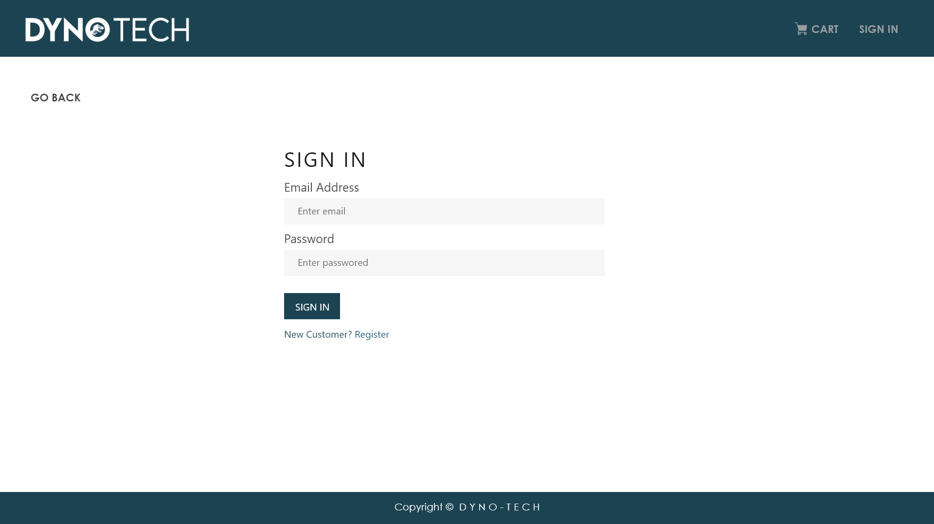
IT20189594
User Profile Management

Slide 5
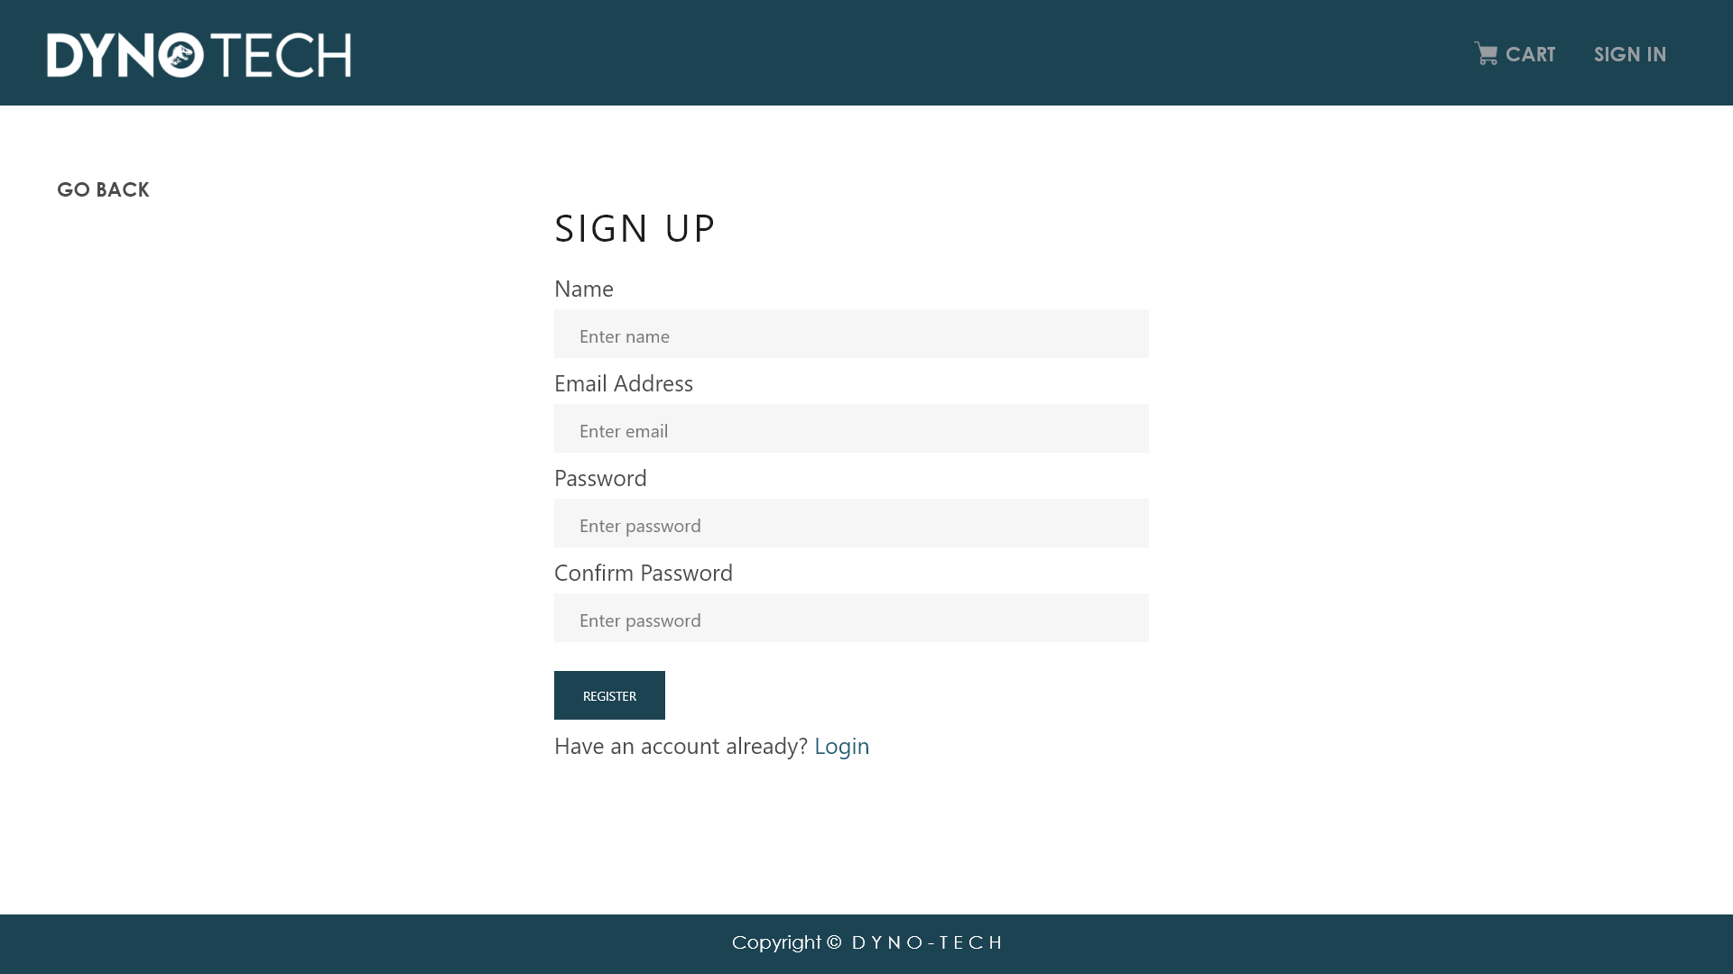
IT20189594
User Profile Management

Slide 6
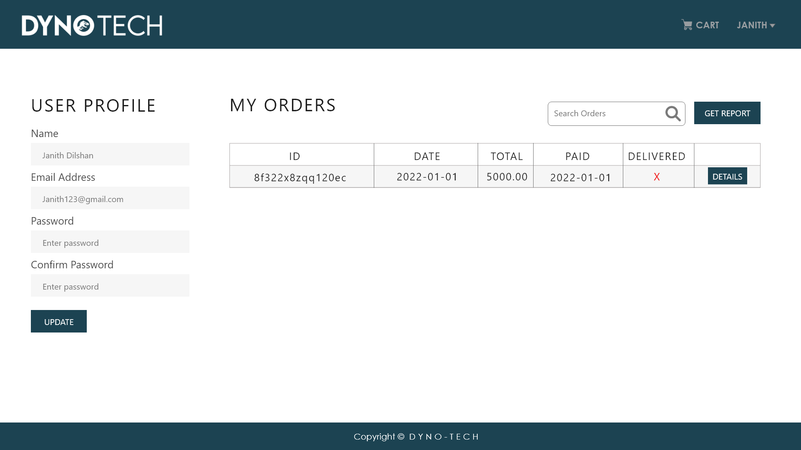
IT20189594
User Profile Management

Slide 7
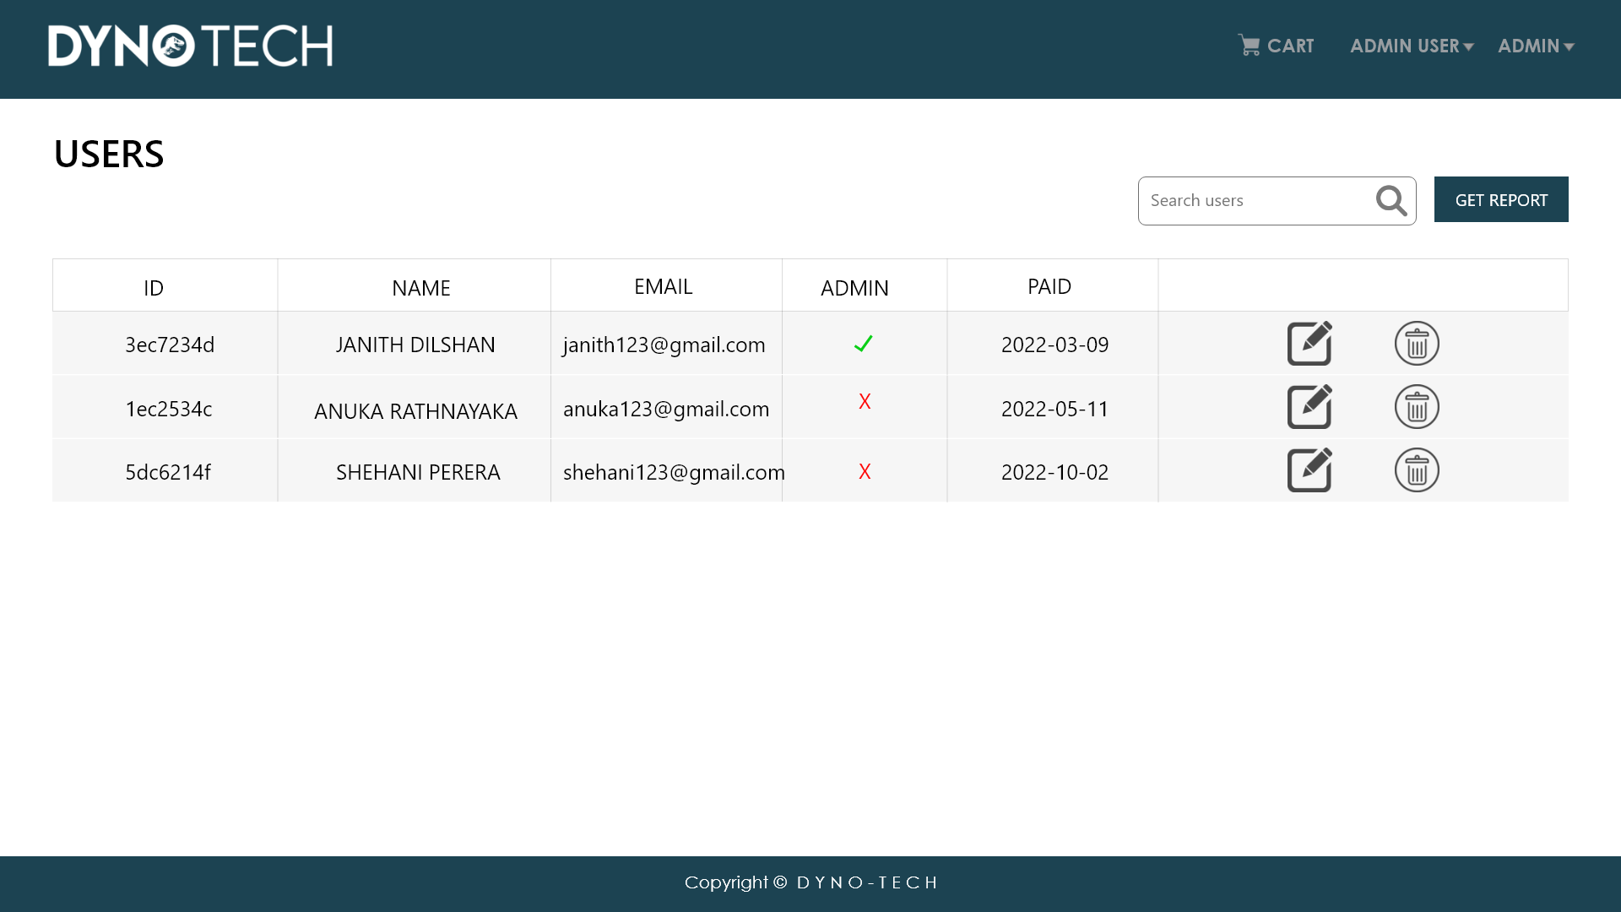
IT20189594
User Profile Management

Slide 8
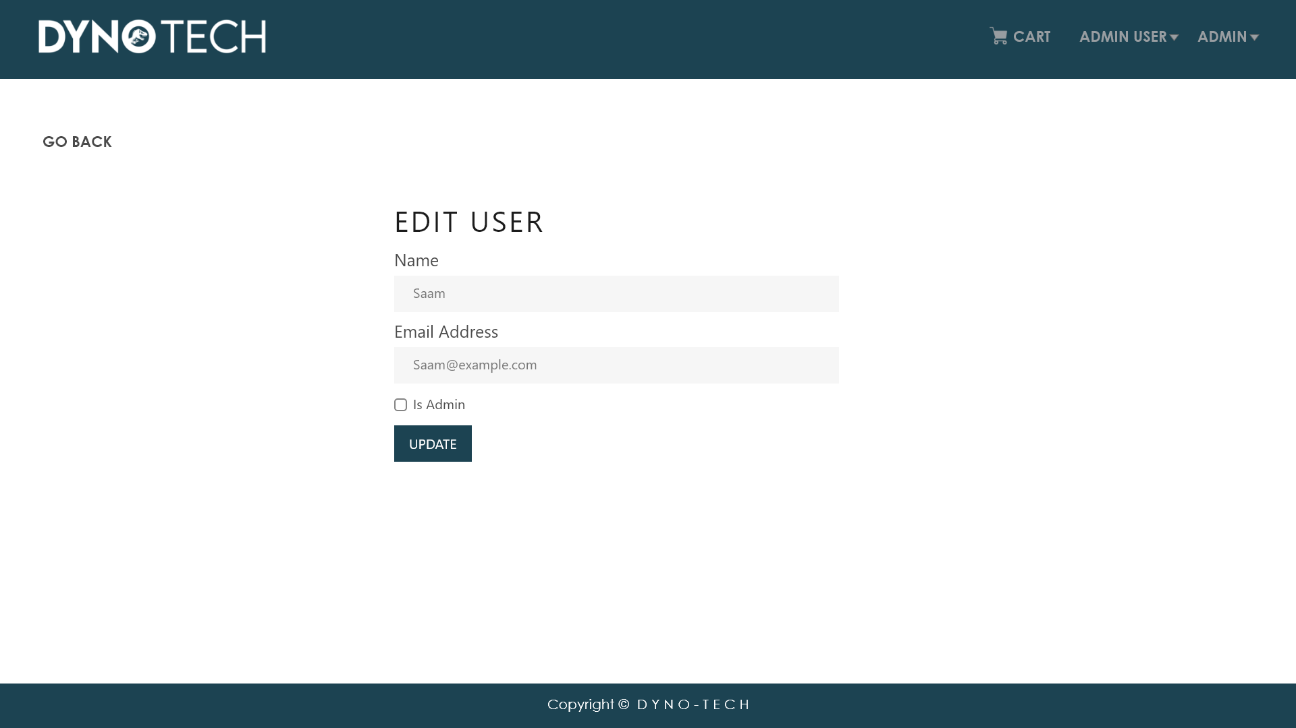
IT20189594
User Profile Management

Slide 9
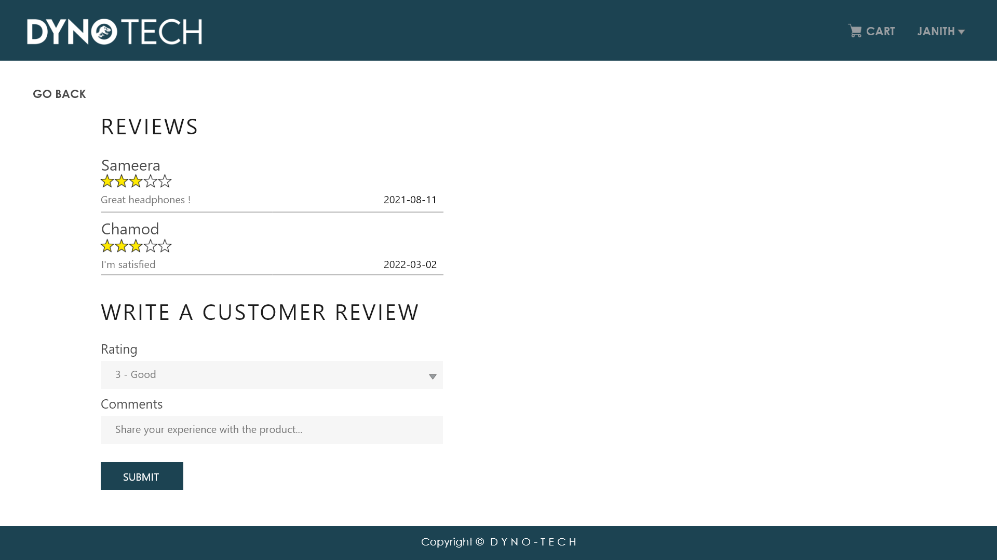
IT20189594
Review Management

Slide 10
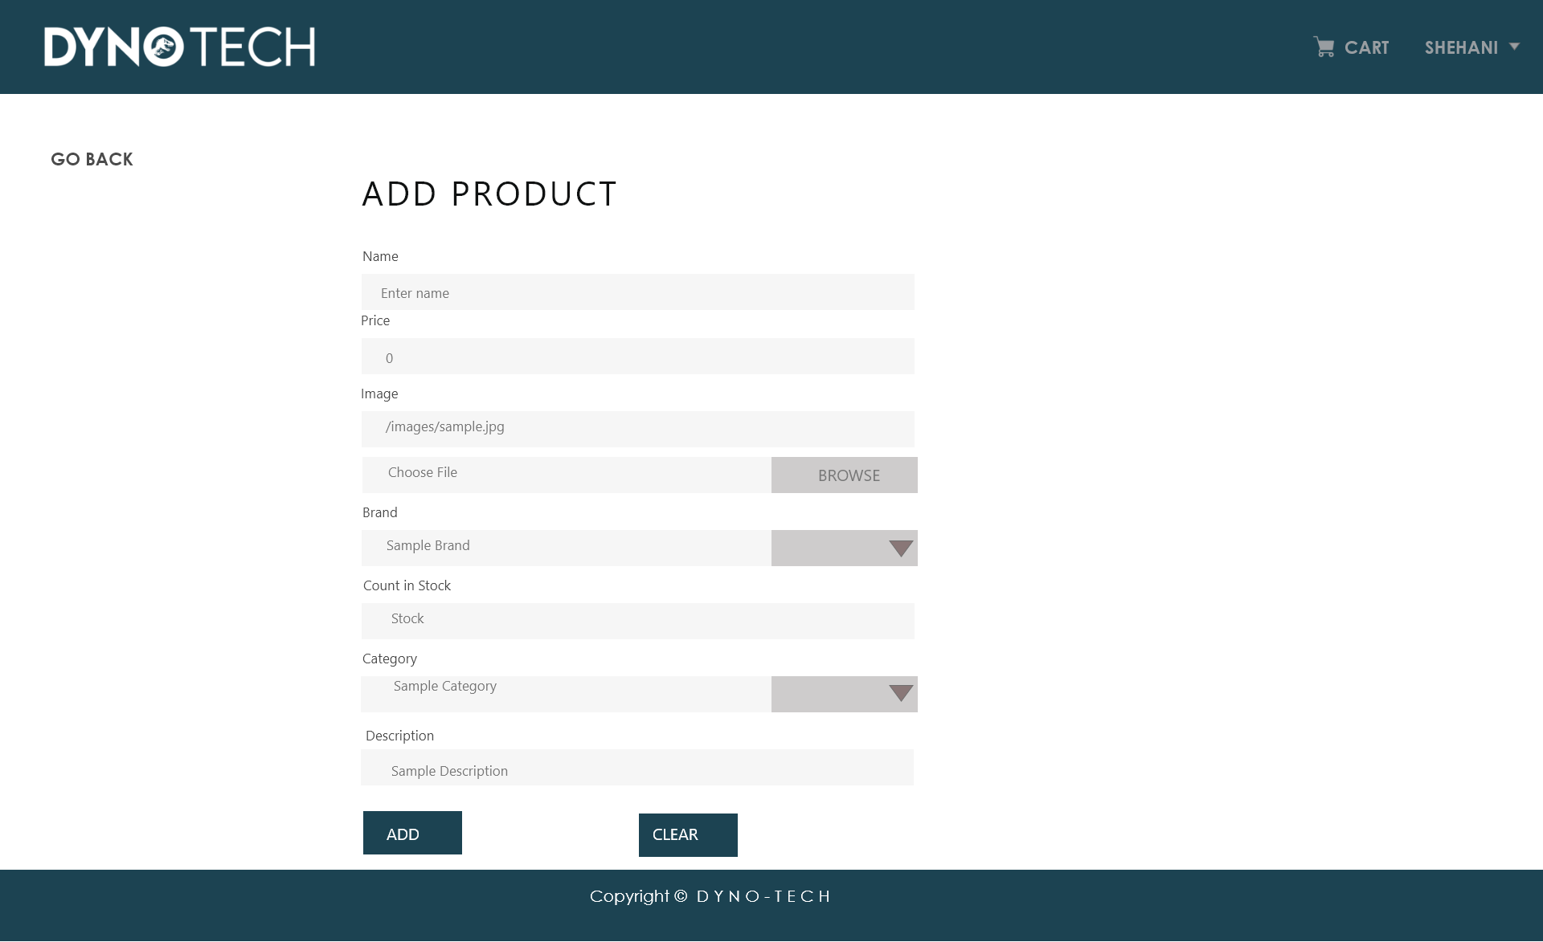
IT20122850
Product Inventory Management

Slide 11
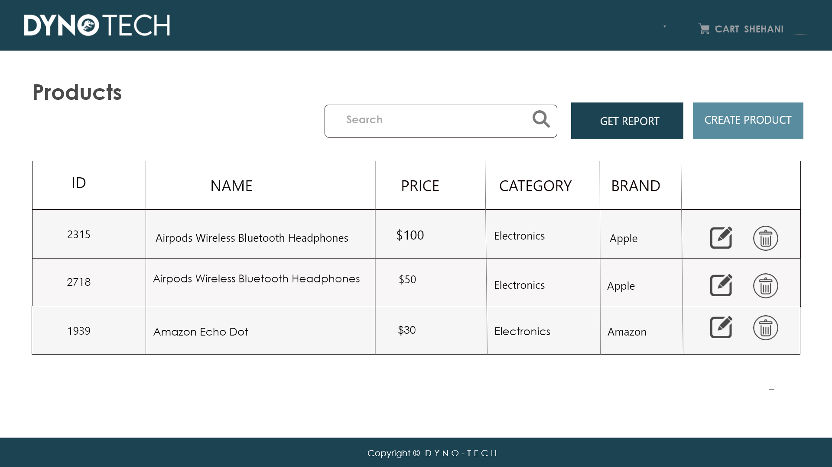
IT20122850
Product Inventory Management

Slide 12
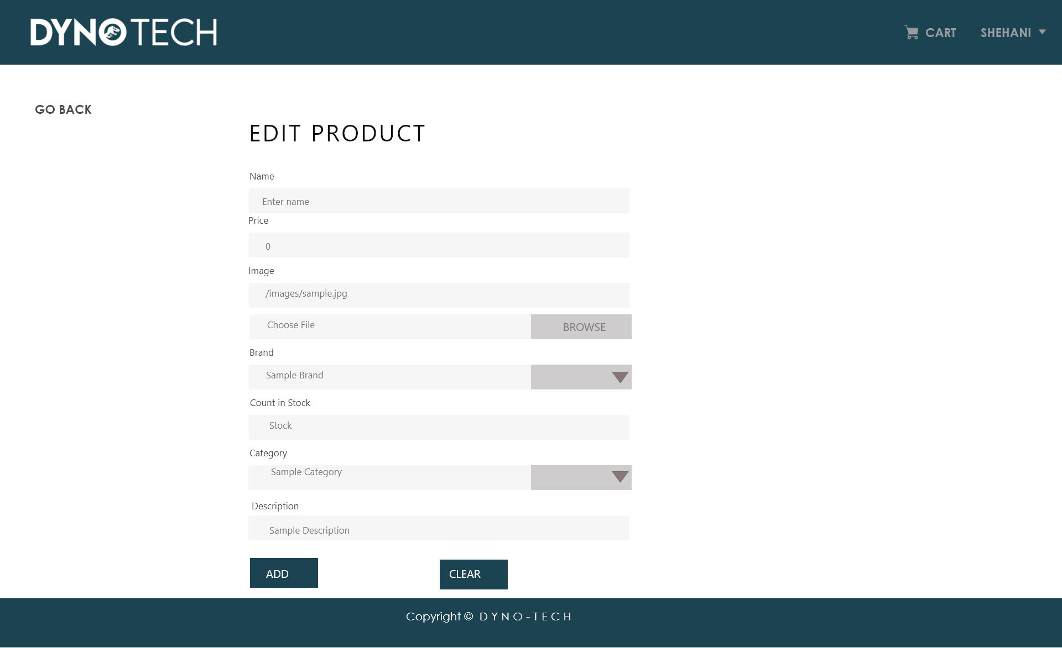
IT20122850
Product Inventory Management

Slide 13
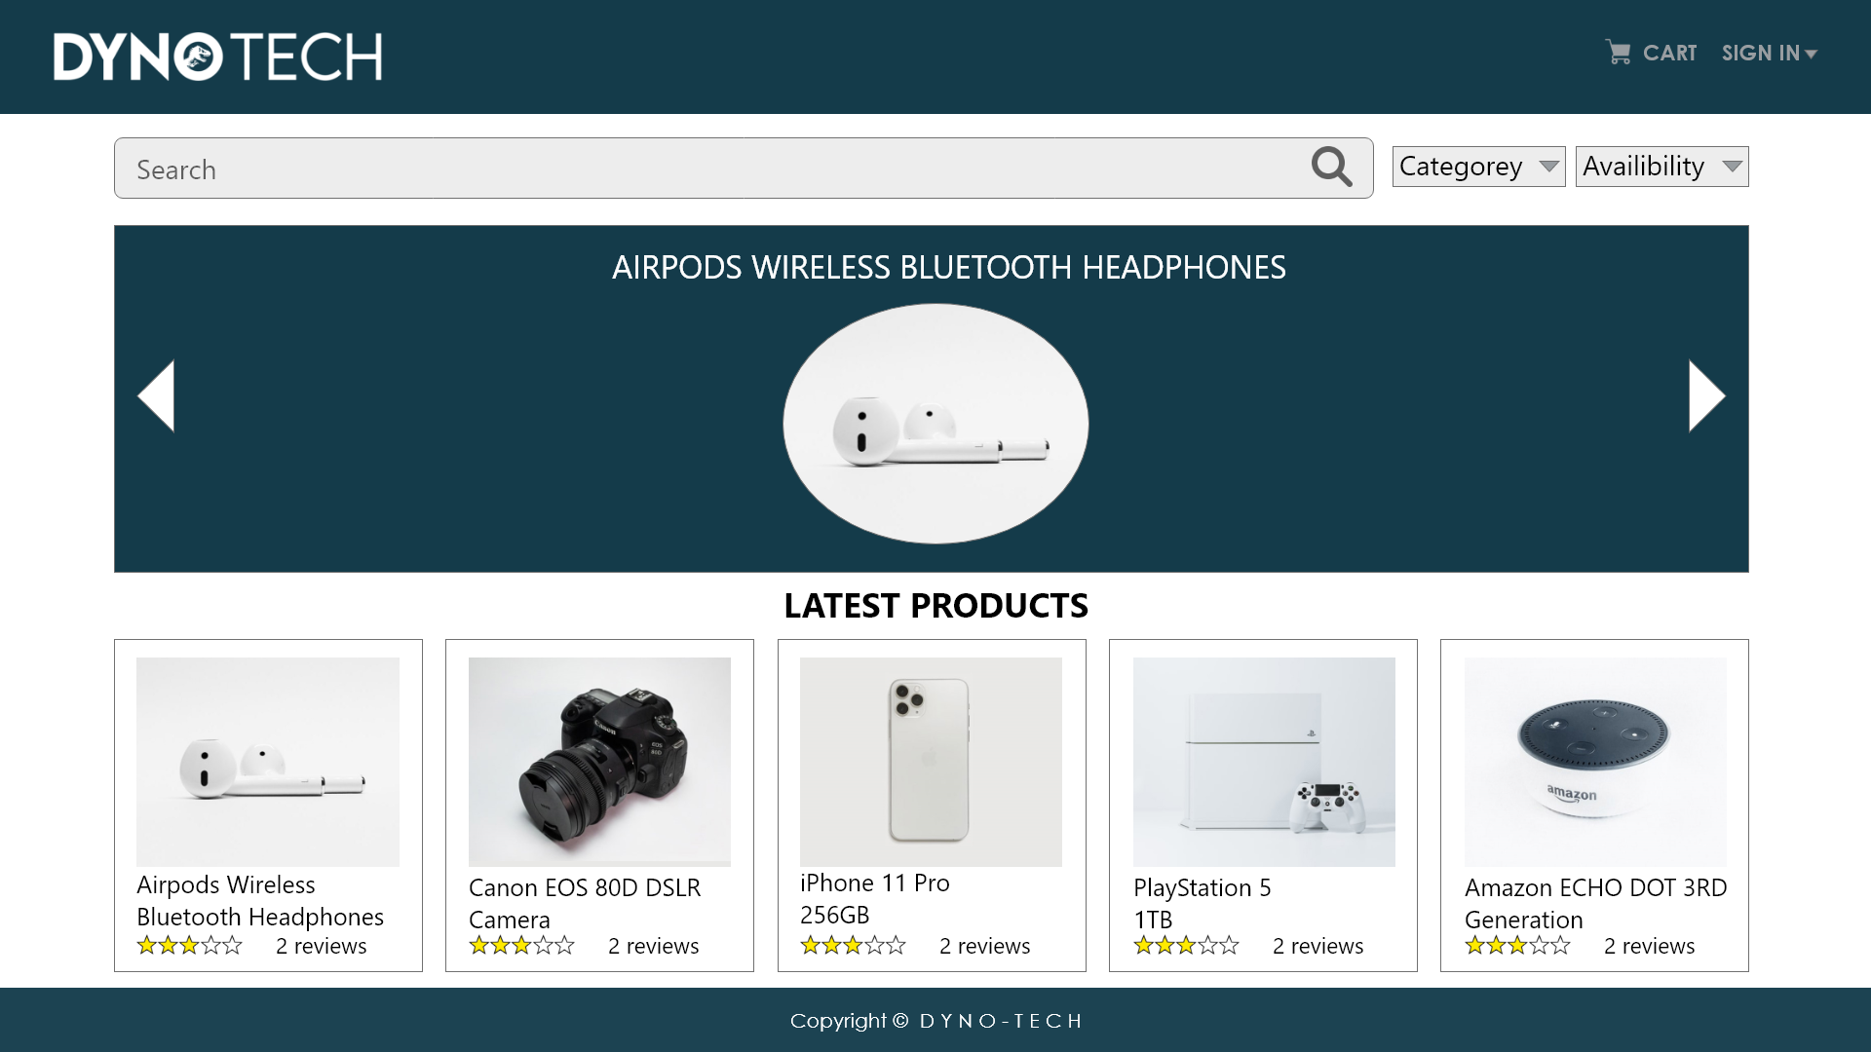
IT20200206
Cart Management

Slide 14
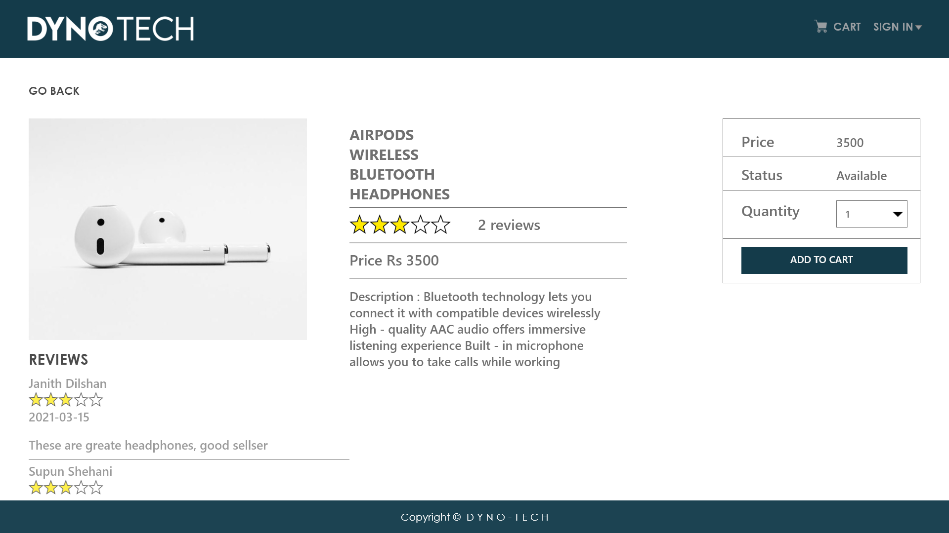
IT20200206
Cart Management

Slide 15
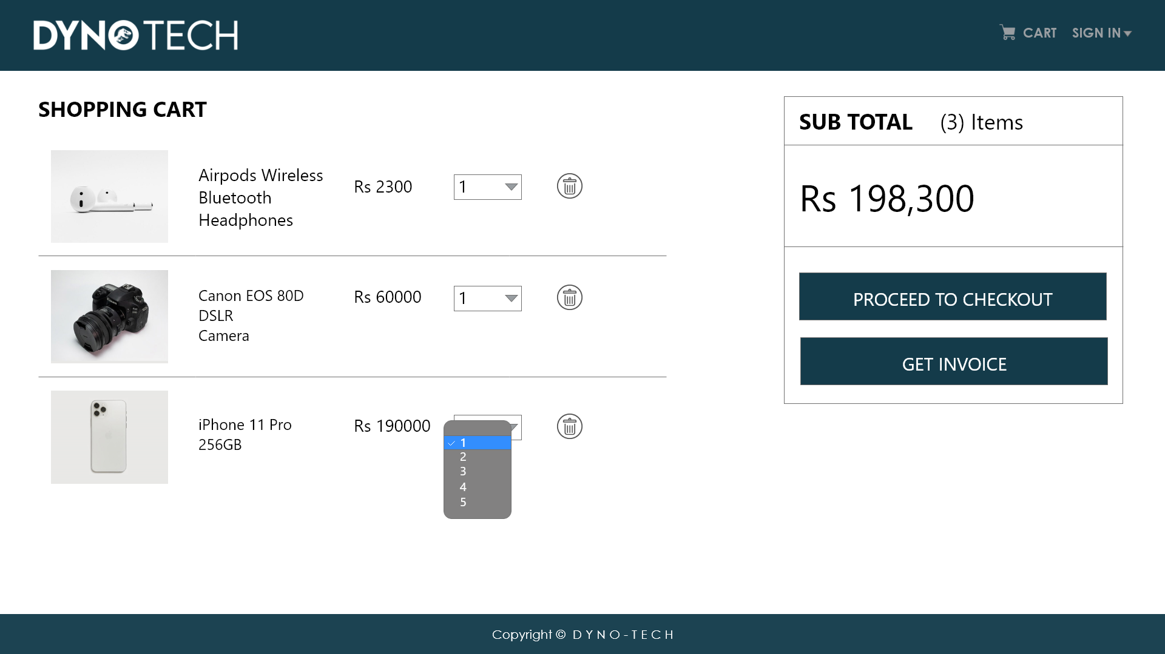
IT20200206
Cart Management

Slide 16
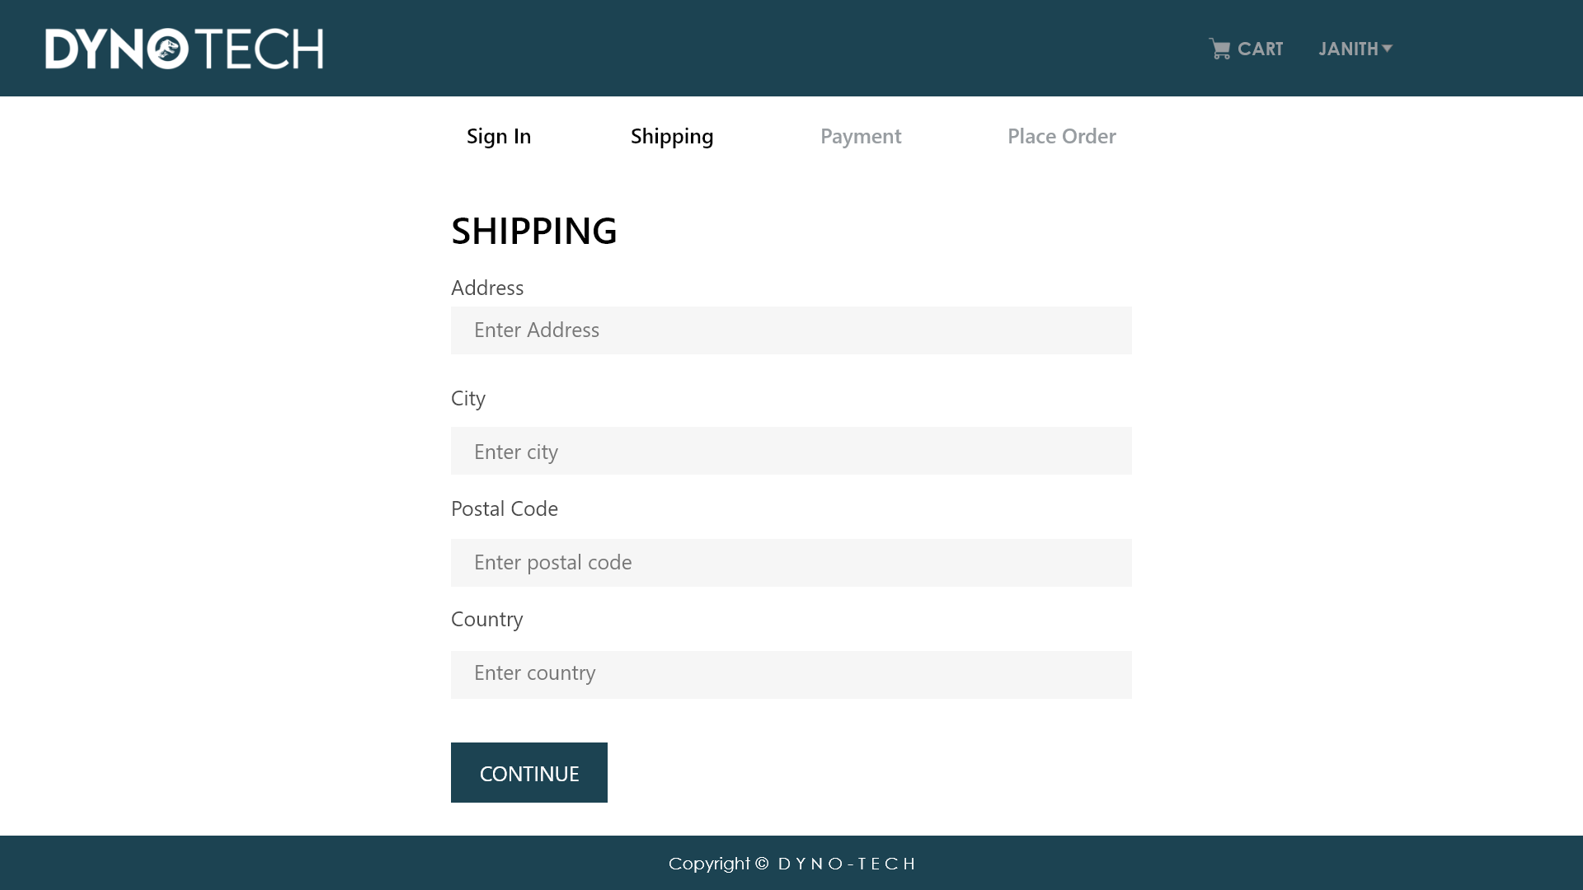
IT20191788
Order & Payment Management

Slide 17
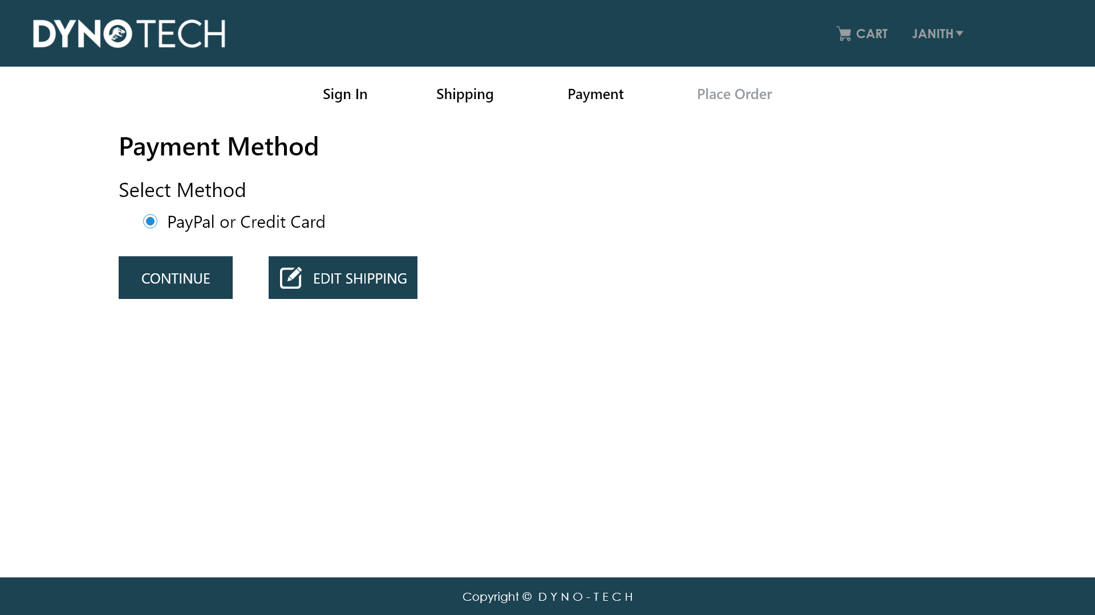
IT20191788
Order & Payment Management

Slide 18
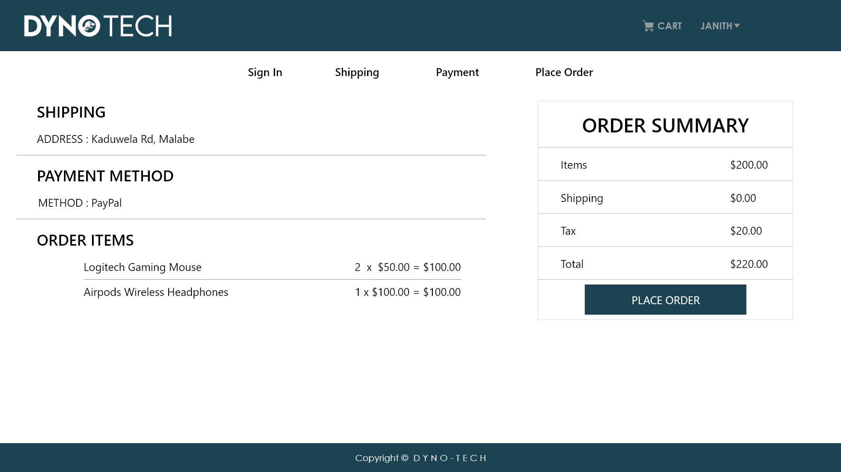
IT20191788
Order & Payment Management

Slide 19
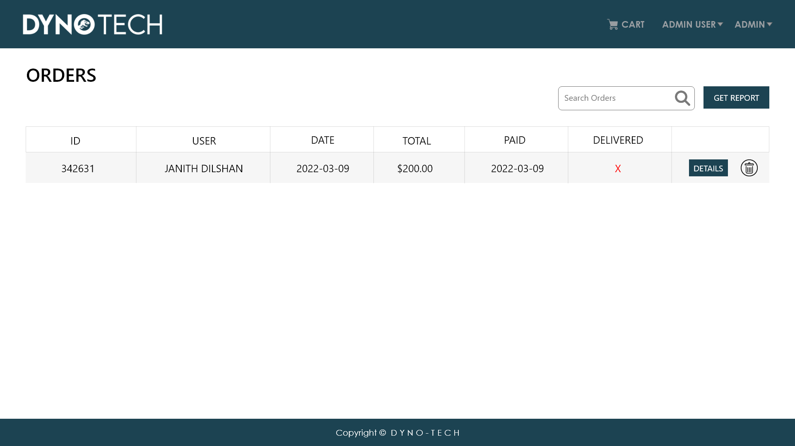
IT20191788
Order & Payment Management

Slide 20
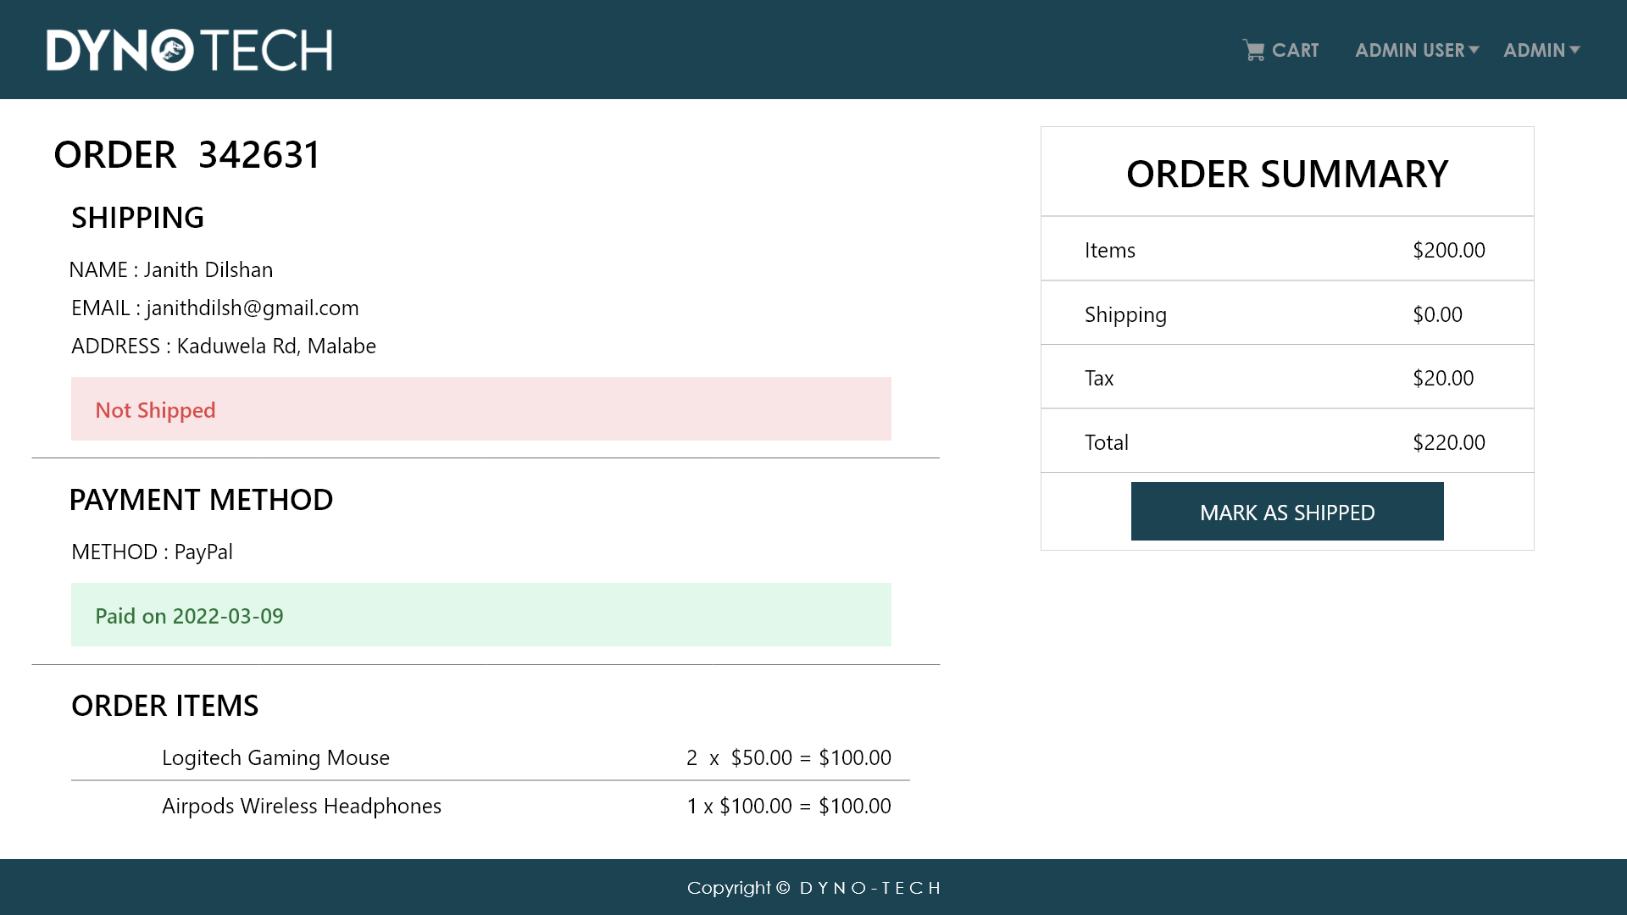
IT20191788
Order & Payment Management

Slide 21
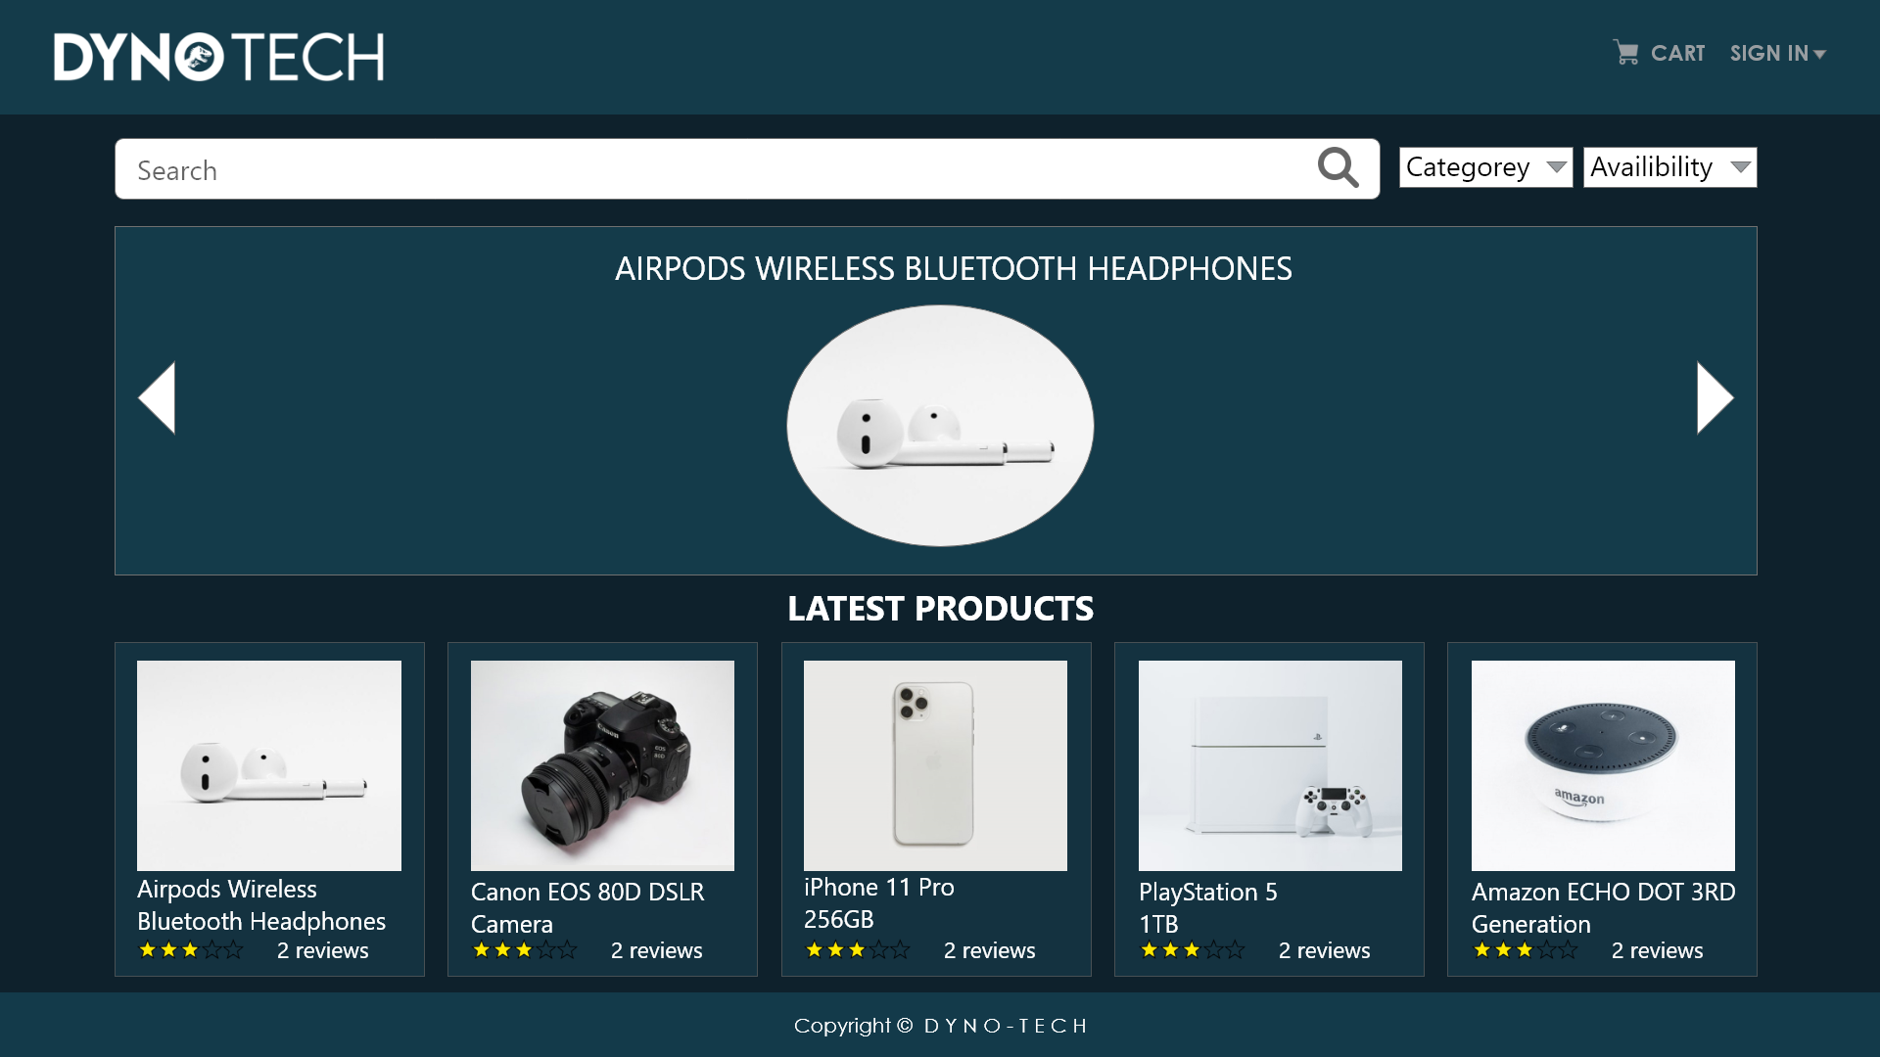
DYNO TECH
Dark Mode UI

Slide 22
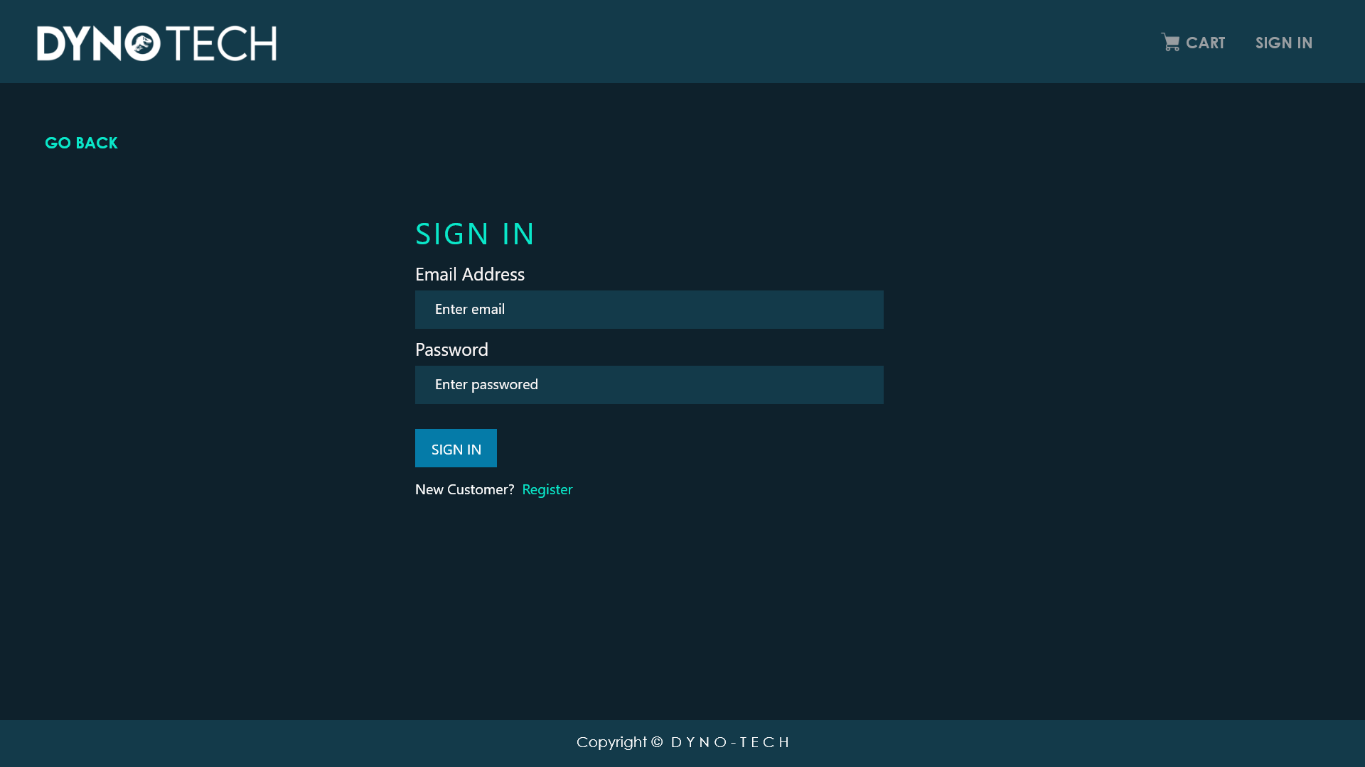
DYNO TECH
Dark Mode UI

Slide 23
THIS IS THE END
THANK YOU

